Slide 1

Enterprise Data
Catalog
Date: 21-April-2025
www.anblicks.com

Slide 2

Unrivaled Objective | Our Understanding
Develop a Data Catalog solution to gather data asset inventory for Unrivaled Team Wear - Company A enabling various business processes
Unrivaled Team Wear - Company A comprises of the following banners 1. Knights Apparel 2. Gear for Sports - College & Bookstore
The objective of this Data Catalog is to arrive at a Heat Map to slice all Company A Corporate Data assets to perform
Assessment & Discovery
Business Impact Analysis
System Fit-Gap Analysis
Target State Business Application Recommendation (Retain/Refactor/Replace)

Slide 3
Anblicks Scope | Our Understanding
The scope and expectation of the Data Cataloging exercise comprises of,
Institutionalizing an Open-Source Data Catalog environment (e.g Data Hub)
Identify Business Process Owners/SME/Stakeholder(s) by business process groups
Identify Corporate Data Domain(s)
Identify & Prioritize Critical Data Elements (CDE) under each Corporate Data Domain(s)
Mapping & Tagging CDE to business process groups & business processes
Analyze Current Data Estate & Inventory
Map it to Current Systems & File Share etc.
Document current Data Quality & Reliability challenges

Slide 4
Our Approach & Perspective | Business Process Groups Coverage
Business Process Groups
Product Development & Innovation
Procurement & Supply Chain Mgmt
Manufacturing and Production
Sales and Marketing
Demand and Supply Planning
Logistics & Distribution
Customer Support and Engagement
Financial Mgmt
Regulatory and Compliance Mgmt
Nine business process groups to be the focus area as a part of Data Catalog Discovery & Assessment
Critical Data Domains shall be identified under each process groups
Data Entities shall be identified, cataloged and tagged to Process Groups and tagged with respective business processes
Current Systems & File Share will be identified as it relates to Data Entities as it relates to respective business processes
HR & Talent Management is assumed to be not the current priority for this engagement as discussed during our discussion

Slide 5
Definitions
Business Process Group
Data Domains
System of Origin
System of Record
Impacted Business Process(s)
Data Quality/Reliability Challenges
Business/SME Comments

Slide 6
Our Approach & Perspective | Illustrative Example to demonstrate Indicative Attributes to be captured in a Data Catalog System
Business Process Group | Data Domains | System of Origin | System of Record | Impacted Business Process(s) | Data Quality/Reliability Challenges | Business/SME Comments
Procurement & Supply Chain Mgmt | Supplier
 | Material & Inventory
 | Procurement
 | Demand Planning
 | Logistics & Transportation
 | Warehouse and Distribution
 | Compliance and Regulatory
 | Invoicing
 | Performance Metrics
 | Sustainability and ESG
 | Supplier Risk Management

Slide 7
Scope
Company A is comprised of the following banners
• Knights Apparel
• Gear for Sports – Non-Under Armour & Destination
• Company B is comprised of the following banners
• Champion Teamwear
• Gear for Sports – Under Armour & Destination (Resort, Golf, Military)
• The objective of this Data Catalog is to arrive at a Heat Map to slice all Company A & B Corporate Data assets to perform
• Assessment & Discovery
• Business Impact Analysis
• System Fit-Gap Analysis
• Target State Business Application Recommendation (Retain/Refactor/Replace)

Slide 8
• The scope and expectation of the Data Cataloging exercise comprises of,
• Institutionalizing an Open-Source Data Catalog environment (e.g., Data Hub)
Identify Business Process Owners/SME/Stakeholder(s) by business process groups
• Identify Corporate Data Domain(s)
• Identify & Prioritize Critical Data Elements (CDE) under each Corporate Data Domain(s)
• Mapping & Tagging CDE to business process groups & business processes
• Analyze Current Data Estate & Inventory
• Map it to Current Systems & File Share etc.
• Document current Data Quality & Reliability challenges

Slide 9
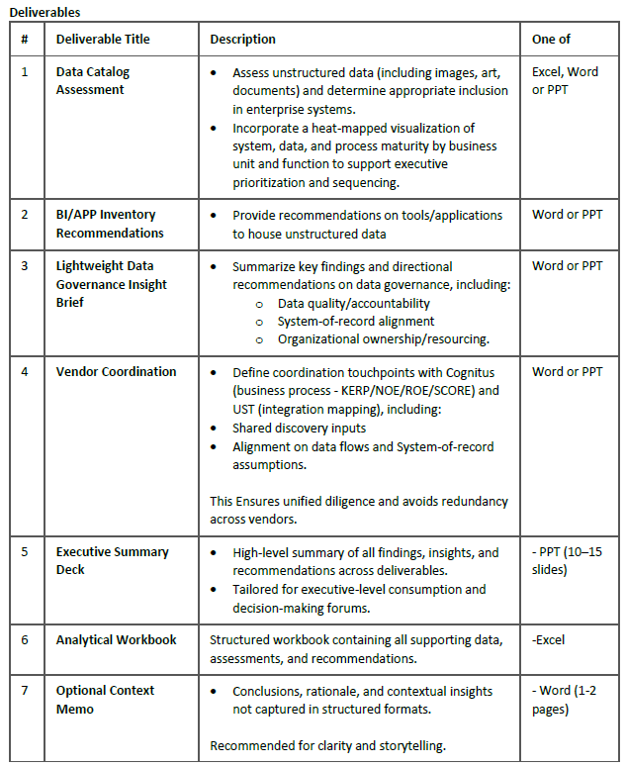

Slide 10
Thank You!
www.anblicks.com
sales@anblicks.com
This presentation contains confidential and proprietary information belonging to Anblicks. It is intended solely for the internal use of Anblicks personnel and authorized recipients. Please do not share, copy, or distribute any content (text, images, video) without explicit written consent from Anblicks.

